Slide 1

Modelling buildings and their heating systems
André Osthövener, Laura Brunn, Lita Ndaba
Tutor: Thilo Hartleif
Notes:
Source picture: https://www.freepik.com/free-photos-vectors/renewable-energy-city
Alternative:
https://www.re-thinkingthefuture.com/architects-lounge/a334-5-renewable-energy-sources-that-are-going-to-impact-the-building-industry-in-the-future/

Slide 2
Motivation for this topic
Goal: climate neutral buildings until 2045
residential buildings are responsible for 30% of greenhouse gas emissions
building energy act came into force on 1. january 2024 and ensures the switch to renewable energy for heating
different paths to archieve climate-neutral houses
→ our task is to analyse some of them
Notes:
Facts from DENA Gebäudereport 2024
part of heat transition is to renovate houses and use new technical building equipment
different paths to archieve climate-neutral houses
our task is to analyse some of them
goal: climate neutrality until 2045
residential buildings are responsible for 30% of greenhouse gas emissions
building energy act came into force on 1. january 2024 and ensures the switch to renewable energy for heating and hot water
2022: 19,5 million residential buildings, 13 million are single-familiy houses

Slide 3
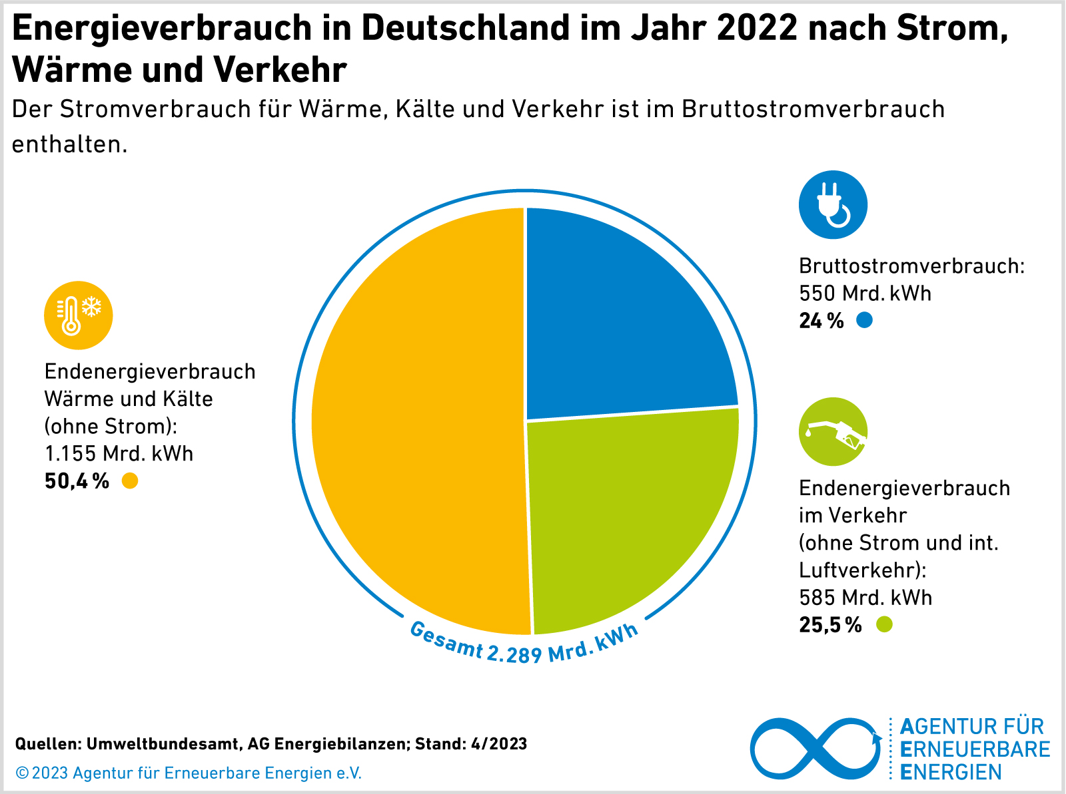
Motivation
Energy consumption in Germany in 2022 by electricity, heating, and transport
In this course, we have mostly focused on electricity from renewable sources
Since we know how to make electricity (the most versatile energy carrier) without carbon emissions:
→ transport and heating / cooling need to be electrified

Slide 4




Introduction – overview building stock Germany

Slide 5
Building stock in Germany
Evolution of energy standards
Overview buildings stock
Overview heating systems
Chosen houses for the scenarios

Slide 6
Building stock in Germany - energy standards
1973 | EnEG: Energy Saving Act regulates energy use in buildings
1977 | WSchV: first Thermal Insulation Ordinance regulating heat insulation of buildings
1978 | HeizAnlV: Heating System Ordinance regulating design and efficiency of heating systems
2002 | EnEV: Energy Saving Ordinance, introduced primary energy demand and U-values as key criteria
2009 | EEWärmeG: Renewable Energies Heat Act, requires use of renewable energies in new buildings
2020 | GEG: Building Energy Act, regulates energy use and renewable integration integration in buildings
Notes:
1973 EnEG enacted in response to oil crisis, regulates energy use in buildings
1977 WSchV: first Thermal Insulation Ordinance regulating heat insulation of buildings
1978 HeizAnlV: Heating System Ordinance regulating design and efficiency of heating systems
2002 EnEV: Energy Saving Ordinance, merged WSchV and HeizAnlV, introduced primary energy demand and U-values as key criteria, several revisions
2009 EEWärmeG: Renewable Energies Heat Act, Germany‘s implementation of the EU Renwable Energy Directive, requires use of renewable energies in new buildings
2020 GEG: Building Energy Act, unifies EnEV, EEWärmeG, EnEG into single law regulating energy use and renewable integration integration in buildings

Slide 7
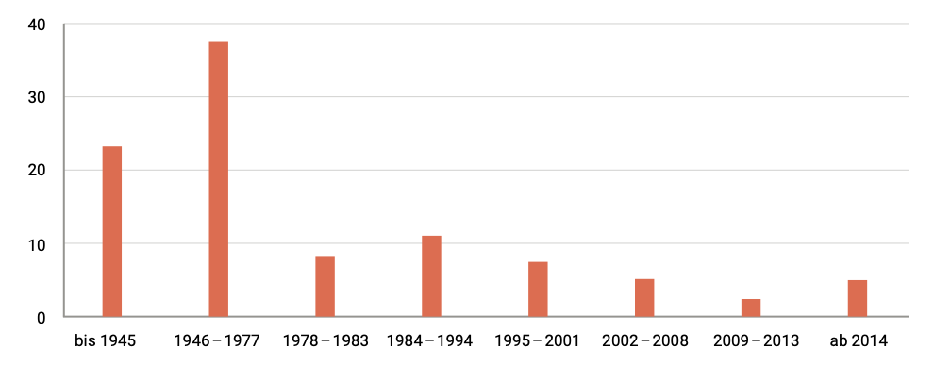
Building stock in Germany – overview buildings
buildings by year of construction in per cent
Notes:
Source: DENA Gebäudereport
roughly 25% of residential building were built before 1946 and 35% between 1946-1977
since the introductions of EnEV 2014 around 1 million = 5% of the residential buildings were built
nearly half of the housing stock are three- and four-room flats

Slide 8





Building stock in Germany – overview buildings
2022: average flat size in new buildings
154 m²
112 m²
76 m²
Trend since 2000:
Average per capita living space:
1990:
34.8 m²
2022:
47.4 m²
Notes:
Source: DENA Gebäudereport
nearly half of the housing stock are three- and four-room flats
In 2022, the average flat size in new builds was around 154 m^2 for detached houses and 112 m^2 for semi-detached houses. There has been a trend towards an increase in the size of detached and semi-detached houses since 2000. This trend can also be applied to room sizes
In multi-family houses, on the other hand, the size decreases and, at around 76 m^2, is generally smaller than that of the other types of flat
Average per capita living space has risen almost steadily since 1990 (34.8 m^2) and was around 47.4 m^2 in 2022

Slide 9
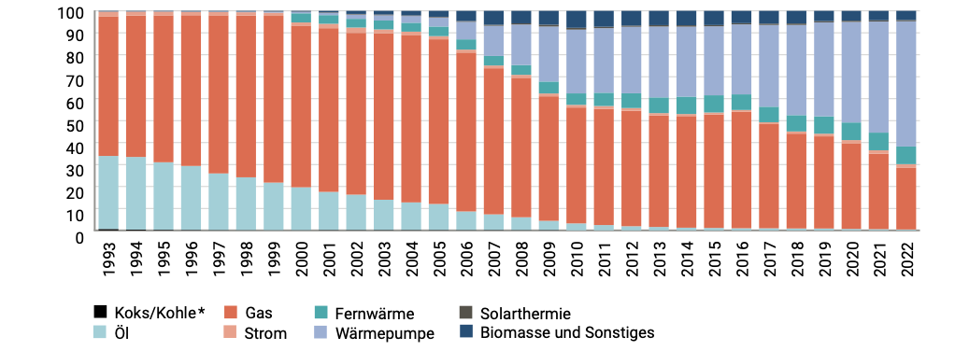
Building stock in Germany – overview heating
proportion of residential units heated by heat pumps has been rising steadily since 2003, BUT: reaching 3% of all buildings in 2022
Coal
Oil
Gas
Elec-tricity
District h.
Heat pumps
Solar
Biomass and other
Completed buildings by energy type in per cent
Notes:
Source: DENA Gebäudereport
from 2000 to 2022, the proportion of completed residential buildings with heat pumps as an energy source increased from almost 0% to 57%.
7,3 % were air-to-water heat pumps, brine-to.water heat pumps, water-to-water heat pumps and hot water heat pumps
proportion of residential units heated by heat pumpps has been rising steadily since 2003, reaching 3% in 2022

Slide 10
Building stock in Germany – overview heating
2022 heating based on renewable energy in 22% of the general housing stock
heat consumption per heated square metre decreases annually due to climate change
the largest areas of application for energy consumtion in residential buildings are space heating (66%) and hot water (16%)
Notes:
Source: DENA Gebäudereport
2022 heating based on renewable energy in 22% of the general housing stock
heat consumption per heated square metre decreases annually due to climate change
the largest areas of application for energy consumtion in residential buildings are space heating (66%) and hot water (16%)

Slide 11
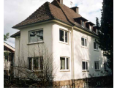
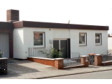

Building stock in Germany – chosen houses
Based on information before, we choose these 3 houses:
25% before 1946 → Tabula data for 1919 - 1948
35% before 1977 → Tabula data for 1958 - 1968
a modern one → Tabula data for 2016
The heating season in Germany is ~200 days per year
Notes:
(https://s2.building-typology.eu/abpdf/DE_N_01_EPISCOPE_CaseStudy_TABULA_National.pdf)

Slide 12
Introduction – heat pump

Slide 13
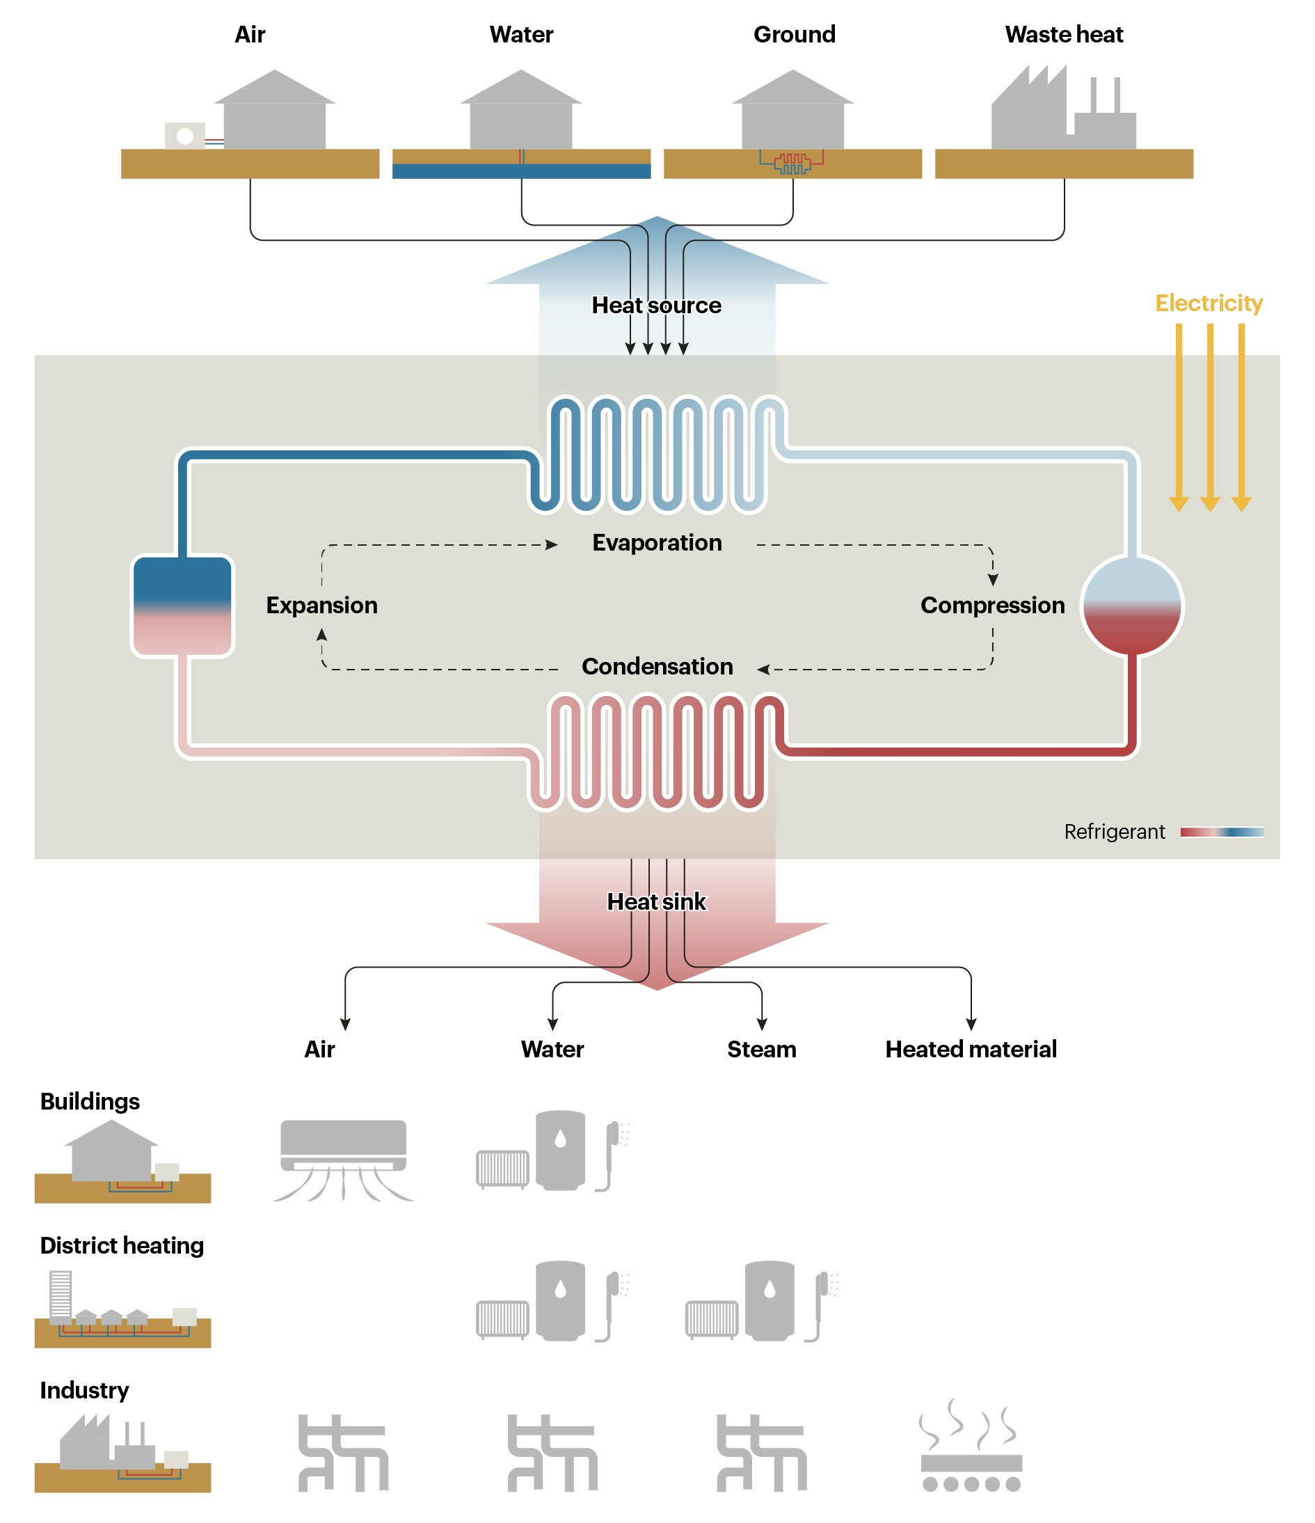
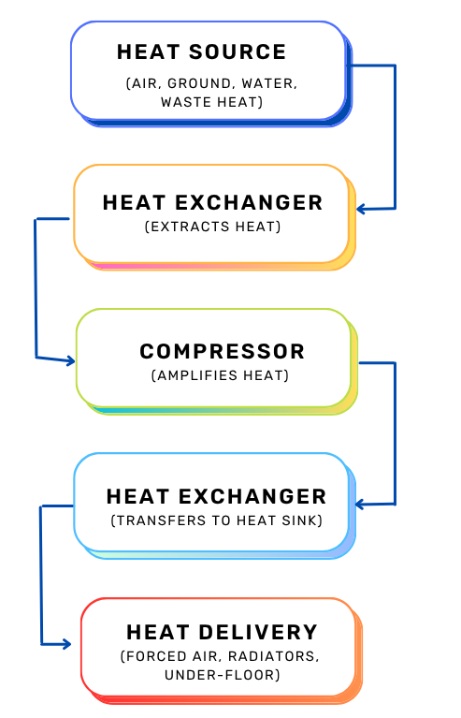
How does a heat pump work - principle

Slide 14
How do different heat pumps work? ASHP vs. GSHP
Feature | ASHP | GSHP
Heat source | air | ground
Heat absorption | absorbs low-grade heat from the outside air using an evaporator coil filled with refrigerant, which evaporates at low temperatures. A compressor then increases the pressure and temperature of the vaporized refrigerant before it releases heat indoors via a condenser. | extracts heat from the ground using a closed-loop system of pipes buried horizontally or vertically, circulating a water-antifreeze mixture. This fluid absorbs thermal energy from the earth, which remains at a relatively constant temperature year-round, and transfers it to the heat pump's refrigerant via a heat exchanger. The refrigerant is then compressed to raise its temperature
cost | not that expensive | expensive
temperature stability | varies with weather | relatively stable around the year
efficiency | lower in cold climates | generally higher, especially in winter
Notes:
Source: https://www.granddesignsmagazine.com/heating/air-source-heat-pumps-vs-ground-source-heat-pumps/

Slide 15
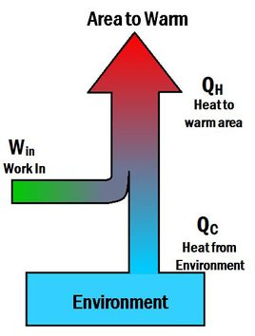
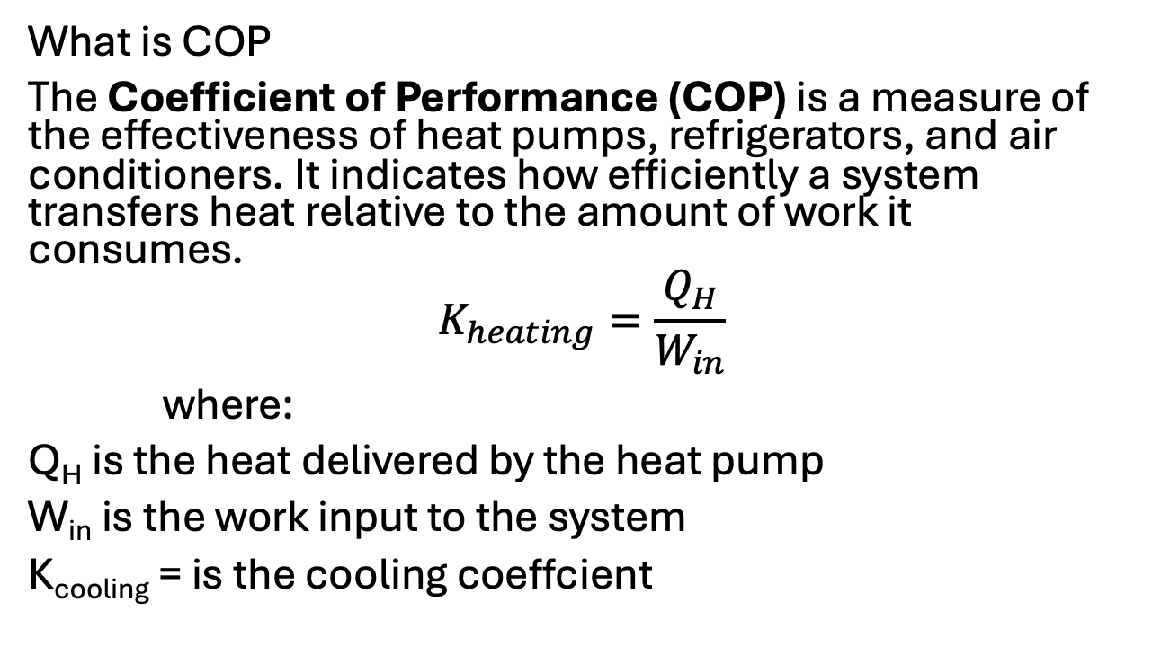
Coefficient of Performance (COP)
What is COP
The Coefficient of Performance (COP) is a measure of the effectiveness of heat pumps, refrigerators, and air conditioners. It indicates how efficiently a system transfers heat relative to the amount of work it consumes.
$$K_{heating}=\frac{Q_{H}}{W_{in}}$$
where:
Q_{H} is the heat delivered by the heat pump
W_{in} is the work input to the system
K_{cooling} = is the cooling coeffcient

Slide 16
How does a heat pump work? -> COP and what influences it
What are the main parameters that influence the COP of heat pumps?
COP = generated heating energy (kWh) / electricity consumed to generate heat (kWh)
source temperature, sink temperature
system design like control devices, compressor, type of refrigerant, length and dimension of piping, sizing of heat exchangers
higher COPs are associated with longer cycle times required for more complete desorption and adsorption processes, resulting in a lower number of cycles per unit time and consequently in lower specific heating or cooling power
How do ASHP and GSHP differ in this context?
GSHP are more efficient, roughly: COP=6, ASHP COP=4
Notes:
https://gebwell.fi/en/news/how-is-the-cop-of-a-heat-pump-calculated-and-what-affects-it/ ;
Vítor A.F. Costa, João M.S. Dias, On the best coefficient of performance and specific heating or cooling power combination for adsorption refrigerators and heat pumps, International Journal of Refrigeration
2023

Slide 17
What are the main parameters that influence the COP of heat pumps?
Source & sink temperatures (higher source/lower sink = better COP)
System design: compressor, refrigerant, heat exchangers, piping, controls
Cycle time: longer cycles = higher COP but lower specific power
ASHP vs. GSHP:
GSHP: Stable ground temps → longer cycles, higher COP (~6)
ASHP: Variable air temps → shorter cycles, lower COP (~4)
Notes:
https://gebwell.fi/en/news/how-is-the-cop-of-a-heat-pump-calculated-and-what-affects-it/ ;
Vítor A.F. Costa, João M.S. Dias, On the best coefficient of performance and specific heating or cooling power combination for adsorption refrigerators and heat pumps, International Journal of Refrigeration
2023

Slide 18

our model

Slide 19

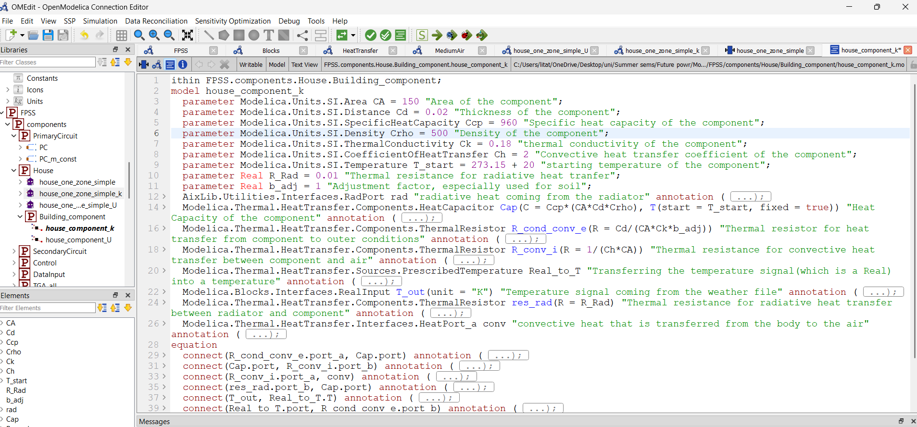
What‘s Modelica
What are the main principles?
object-oriented, equation based, declarative modeling language
designed to model complex physical systems involving multiple physical domains like mechanical, electrical, thermal

Slide 20

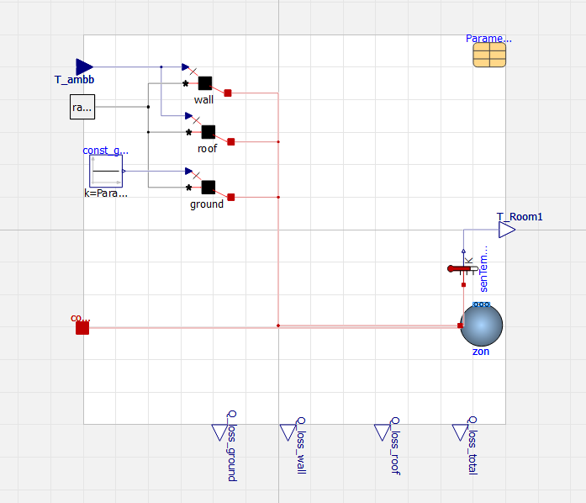
What‘s Modelica
What are main differences to other modelling tools?
Uses equations to describe relationships rather than commands
Components can easily be reused in different configurations
Several pre-built components for physical modeling
Has symbols to represent the physical model
Notes:
And we added the window manually

Slide 21

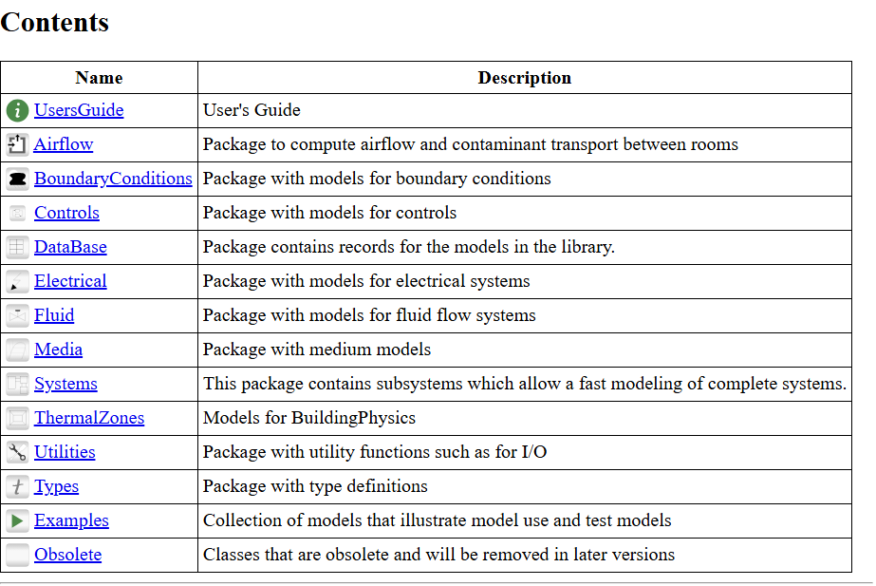
What‘s Modelica - AixLib
is a library designed for modeling and simulating building energy systems
based on IBPSA library (International Building Performance Simulation Association)
provides models for
Heating, Cooling,
Ventilation Systems
Building Envelope
Control Strategies
Weather Data Handling

Slide 22
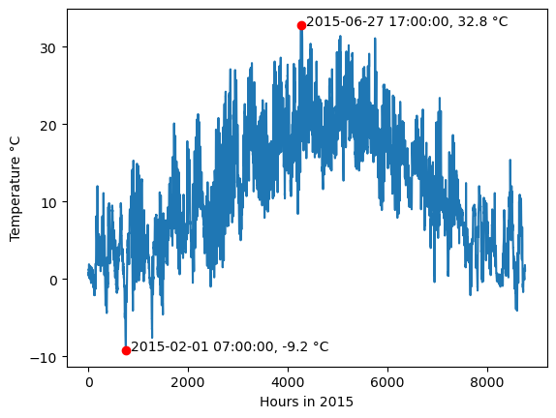
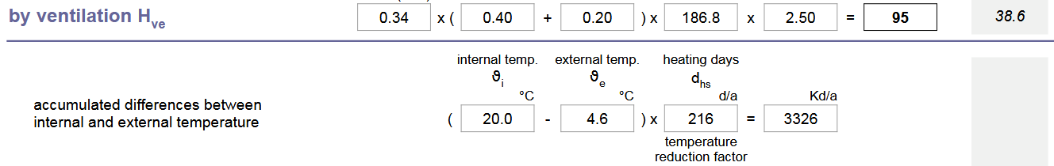
TRY Weather data (2015)
Tabula heating days:
Notes:
Show map animation. Thilo pointed us to TRY → has lots of data. We only look at the 1d time series for Oldenburg. And within that, only at the 200-ish days between October 1st and April 30th.

Slide 23
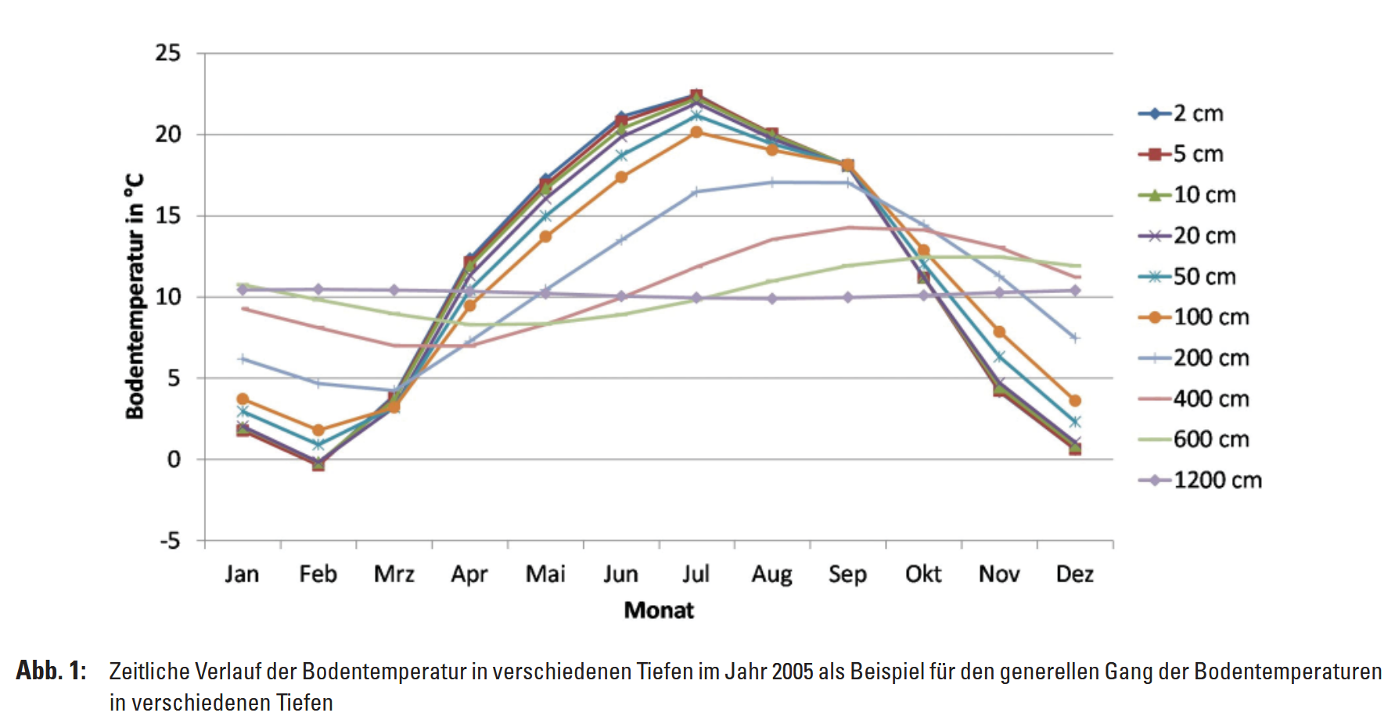
Assume ground temperature as constant
The default heat pump in the model has a nominal power of 5.5 kW

Slide 24
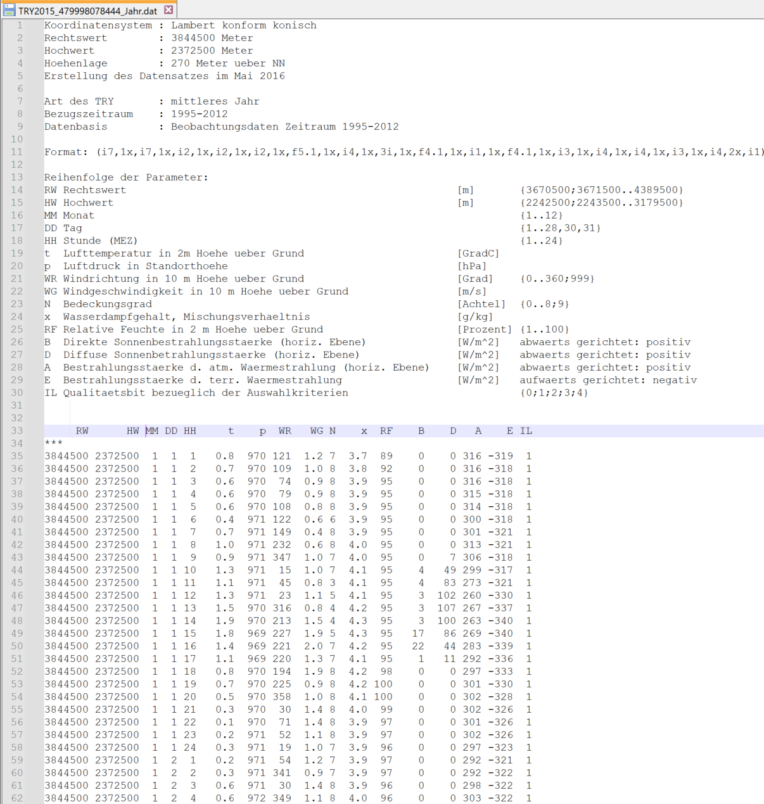
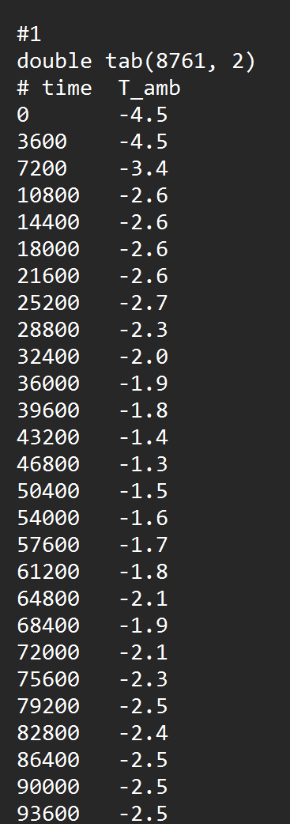

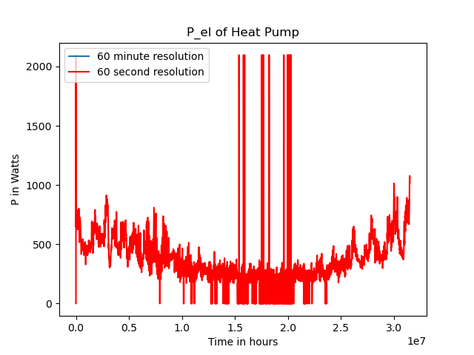
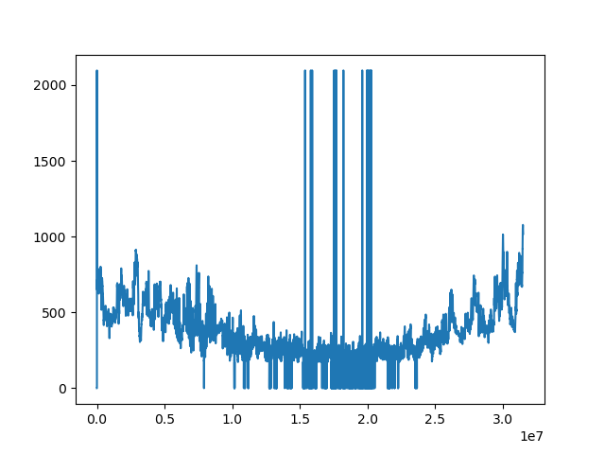
Preprocessing
Custom Python script to reformat temperature data
Write custom files with all building parameters
Before Simulation
Choose weather and building file
Modelica‘s “dassl“ integratior actually adapts the step size
It takes >10 minutes to run a full year (summer chaotic)

Slide 25
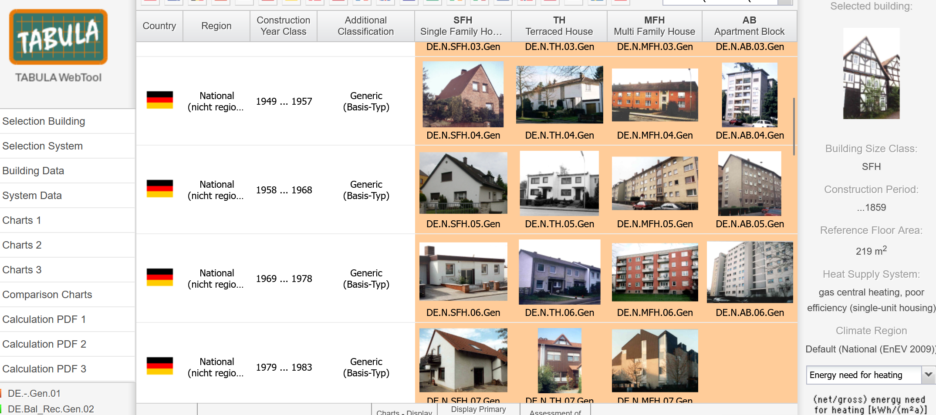
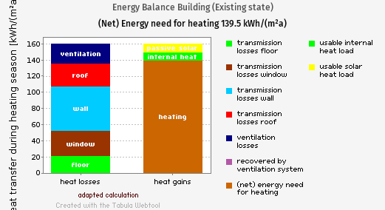
Parameters
Tabula website with building stock data across Europe
Validate the model by checking if results can be reproduced with real data
No ventilation, no internal heat source, no solar irradiance
https://webtool.building-typology.eu/?c=de#vares

Slide 26
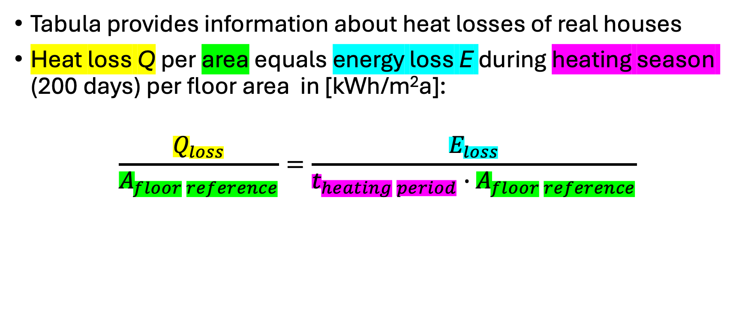
Validating the model with Tabula
Tabula provides information about heat losses of real houses
Heat loss Q per area equals energy loss E during heating season (200 days) per floor area in [kWh/m²a]:
$$\frac{Q_{loss}}{A_{floor reference}}=\frac{E_{loss}}{t_{heating period}∙A_{floor reference}}$$
Notes:
Because heat is power (in Watts)

Slide 27
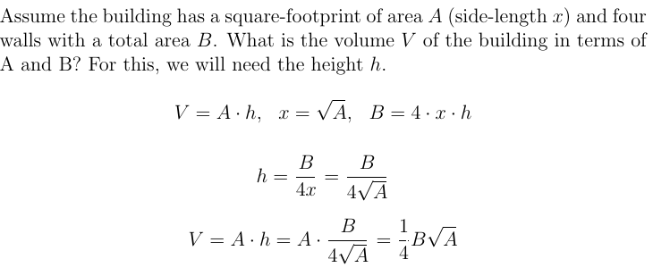
Tabula parameters
Tabula provides the surface area and thermal transmittance (U) of the components: floor, walls, windows, roof
For the model, we also need the volume of air inside

Slide 28
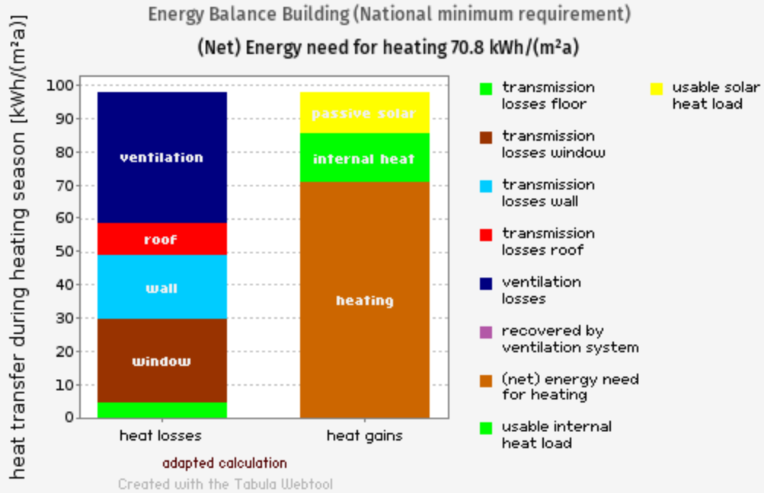
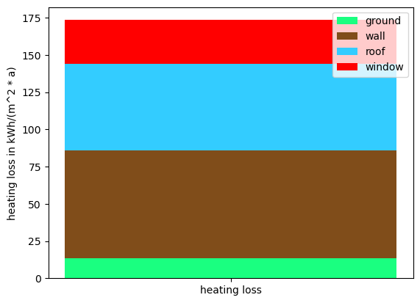
Validating the model with Tabula – example
Typical building explain plots here??

Slide 29
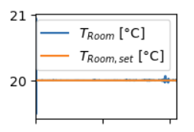
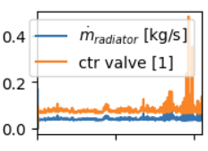
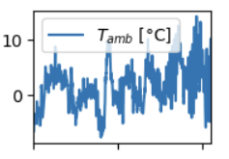
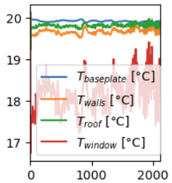
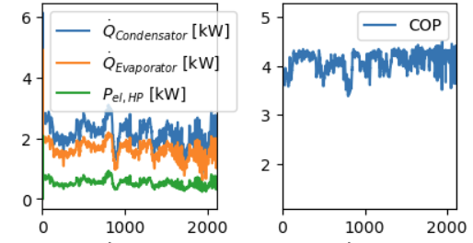
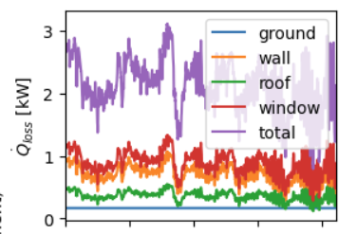
Comparisons (relevant plots)
Controller
Misc
Heat pump
Building

Slide 30

How are different types of building performing?

Slide 31
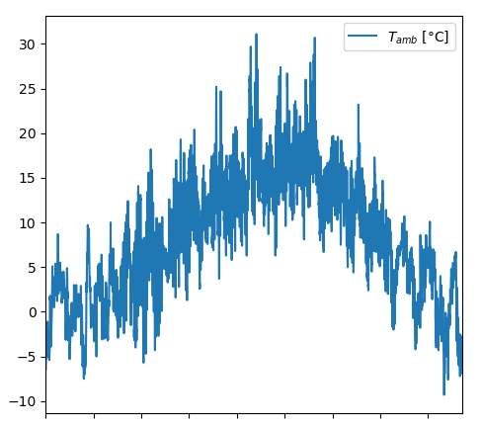
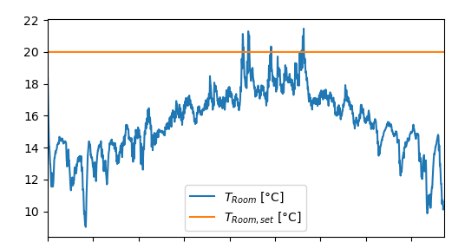
1978 typical building in 2015 weather
Simulate entire year
Heat pump fails to meet room set temperature
Only when ambient T is >20°C, so is T inside → heat pump too weak for this level of insulation

Slide 32
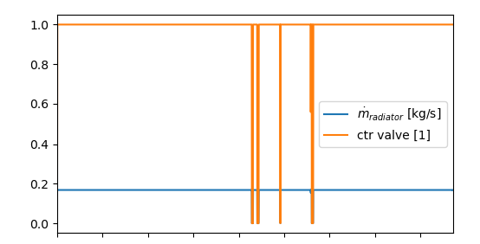
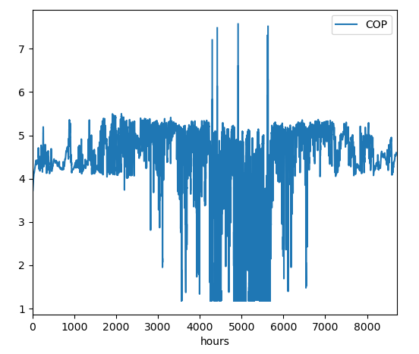
Heat pump‘s control valve was opened completely, so that‘s not the bottleneck
The average COP (during heating period) was 4.5 … this is a measure of efficiency, not effectiveness

Slide 33
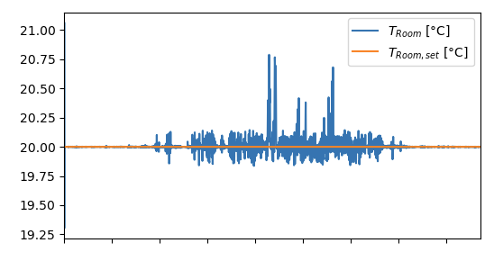
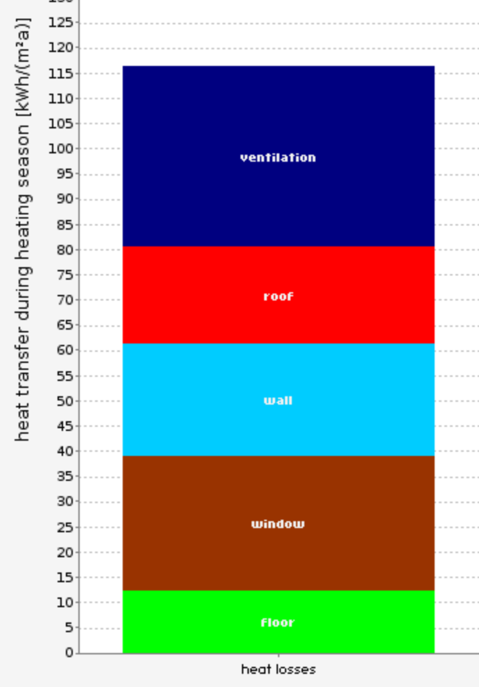
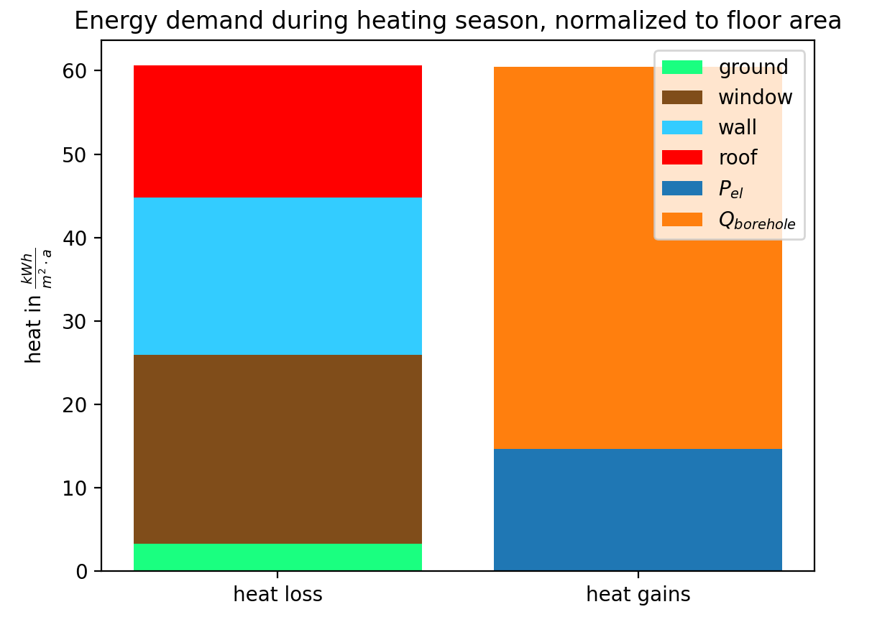
1978 refurbished building
Set T reached
Ventilation not modelled
Error potentially explained by different weather data, location, etc.
Qualitatively satisfactory
Tabula claims Our results

Slide 34
Losses = Gains
All energy that went into the house must be lost as well
The blue electrical energy pumped the orange heat from the Earth into the building.

Slide 35
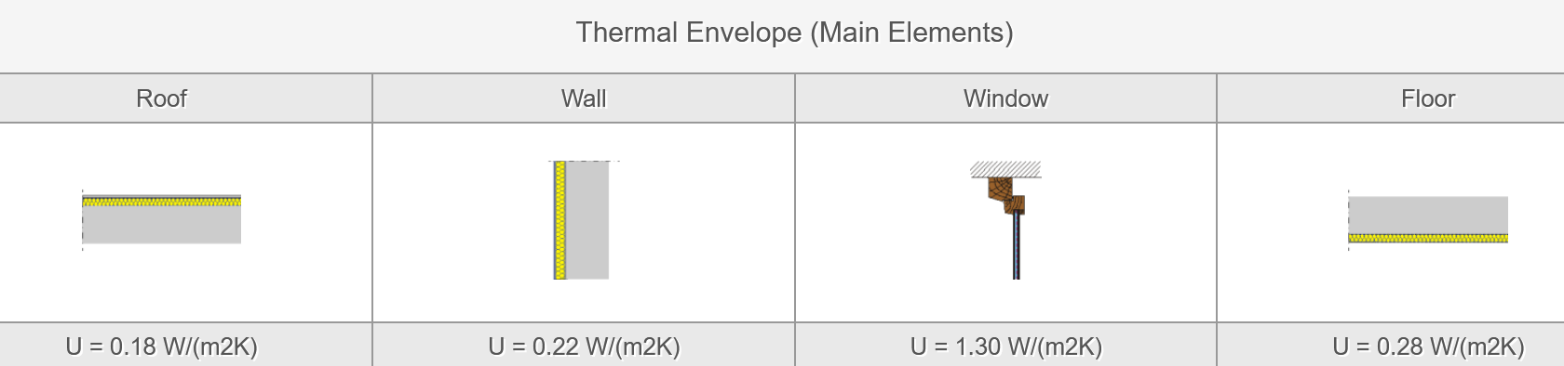
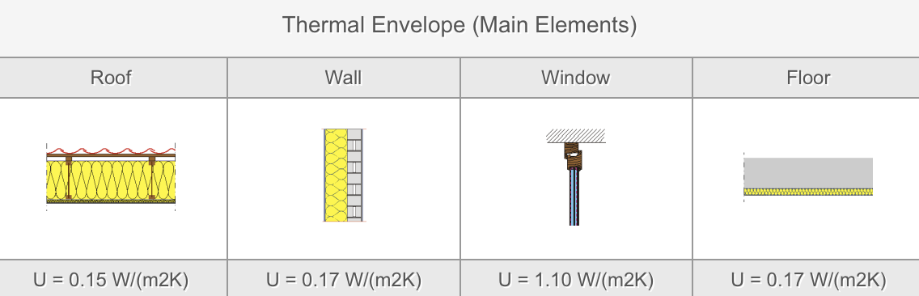
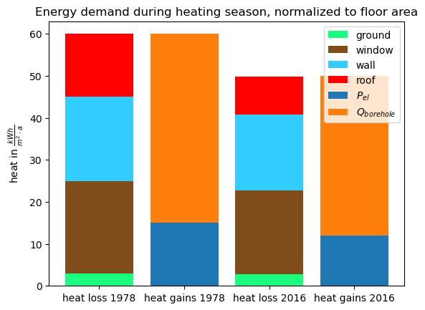
1978 refurbished vs 2016 building
Notes:
Many non-linearities, but as a rough estimate: sum of U-values is 20% less for 2016 building, and it‘s losses (and therefore energy demand) is about 17% less

Slide 36
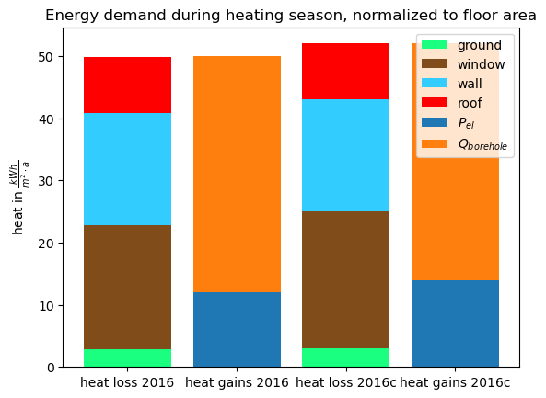
2016 building in normal vs cold winter
Larger discrepancy in modern building with good ventilation system
Cold winter needs 8% more electricity (from 2322 to 2513 kWh) to provide 9350 kWh worth of heat energy

Slide 37
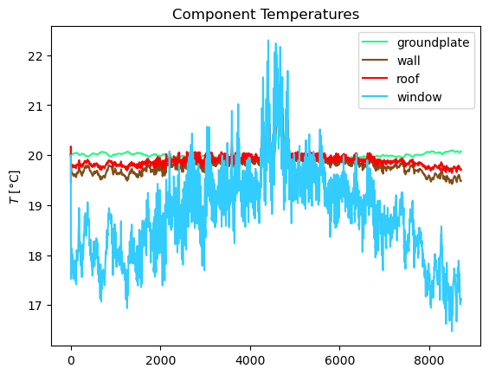
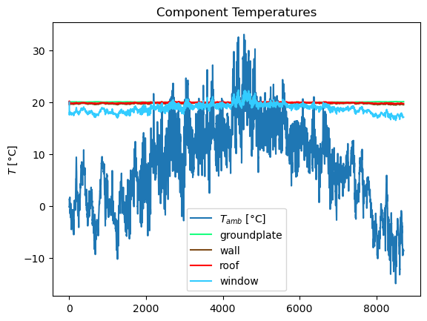
2016 building temperatures in cold winter
Notes:
Glass is like a mini-replica of the temperature curve.
Wall, roof, and floor are more stable because they have more thermal mass.
Its area is small enough that it doesn‘t heavily contribute to losses.

Slide 38
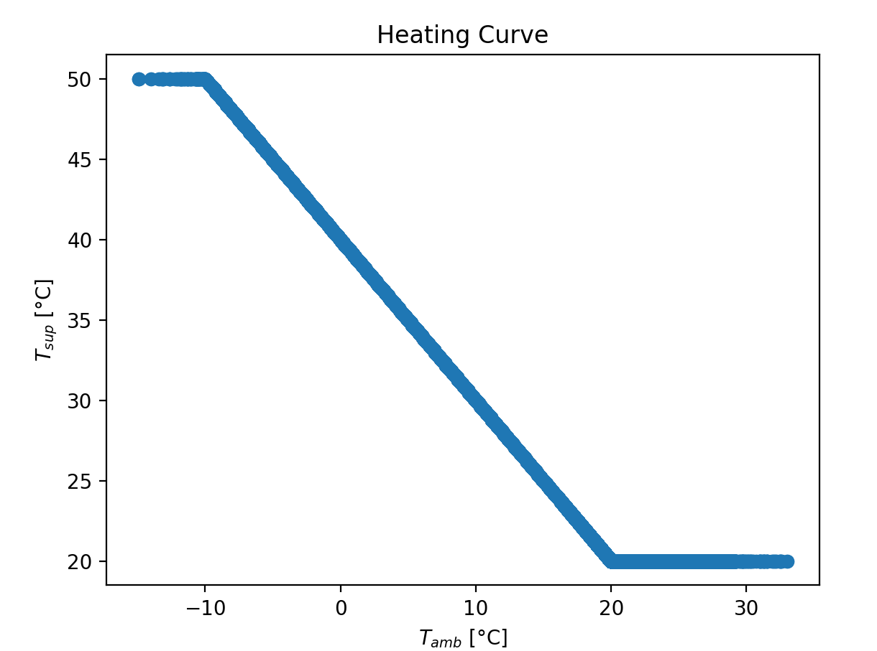
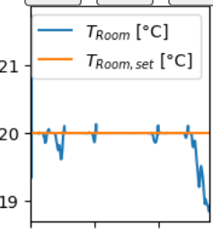
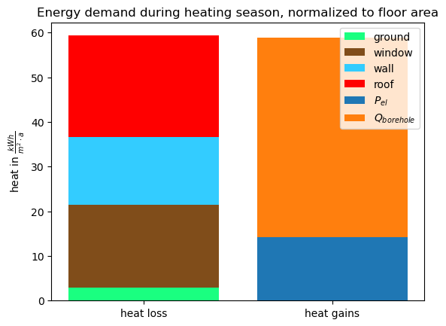
1948 refurbished building in 2015
T_HC_1_amb=273.15-20, T_HC_1_sup=273.15+70, T_HC_2_amb=273.15+20, T_HC_2_sup=273.15+20
Notes:
But that needed HP=2 and T_HC_1_amb=273.15-20, T_HC_1_sup=273.15+70, T_HC_2_amb=273.15+20, T_HC_2_sup=273.15+20

Slide 39
Different housing types - conclusion

Slide 40

What does a night setback change?

Slide 41
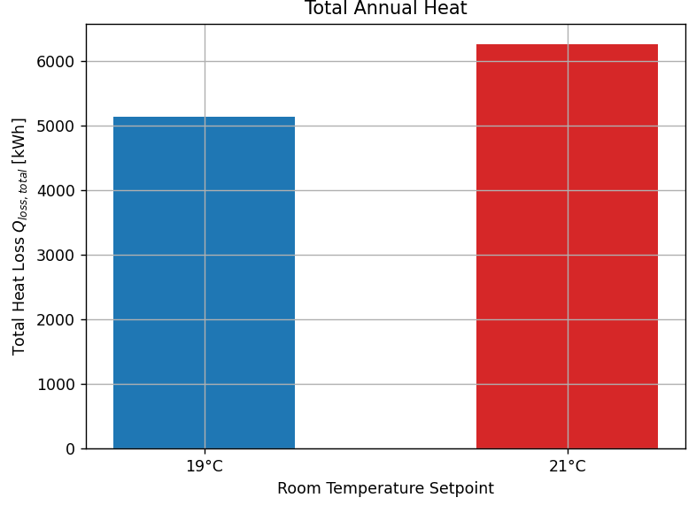
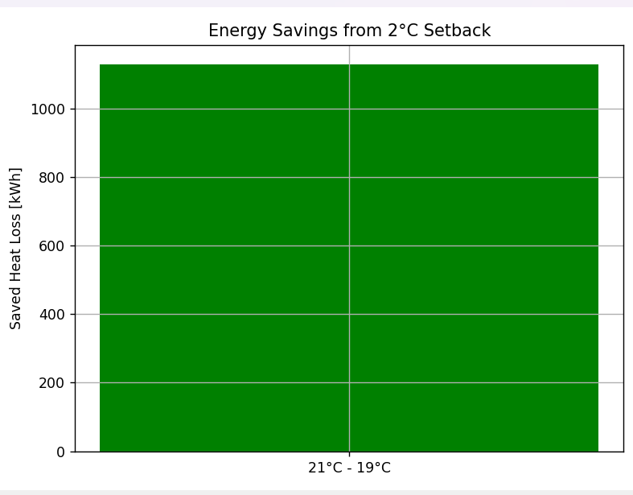
Night setback difference 2015 normal
„old“ building 1978
„new“ building 2016

Slide 42
Night setback difference 1977 normal
„old“ building 1978
„new“ building 2016

Slide 43

Night setback - conclusion
For the 2016 building we can save 1128.8 kWh from utlizing a night setback

Slide 44

How will buildings perform in future weather scenarios?

Slide 45
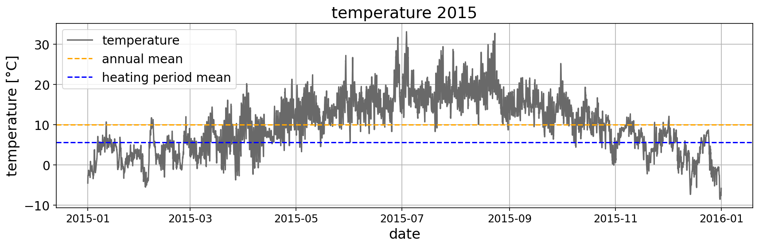

2016 house 2015 and 2045 weather compared
What is the difference between winter 2015 and 2045?
Notes:
Jan-Apr

Slide 46


2016 house 2015 and 2045 weather compared
2015
49.8 kWh/m2a
2172.7 kWh in heating period
Notes:
Jan-Apr

Slide 47

2016 house 2015 and 2045 weather compared
2015
49.8 kWh/m2a
2172.7 kWh in heating period
2045
43.63 kWh/m2a
1839.3 kWh in heating period
Notes:
Jan-Apr

Slide 48

2016 house 2045 normal weather and cold winter compared
What is the difference between a normal and a cold winter?

Slide 49

2016 house 2045 normal weather and cold winter compared
2045
43.63 kWh/m2a
1839.3 kWh in heating period
2045
51.9 kWh/m2a
2380 kWh in heating period

Slide 50


Notes:
Clamping with np,maximum(losses,0) because negative losses are not hepful for performance assessment

Slide 51
Future weather - conclusion
Normal weather 2045 and 2015 are not that different
Cold winter 2045: the few very cold days lead to more loss
To prevent loss: most loss window and wall -> better isolation of window and wall in future houses

Slide 52
Conclusions I
Most losses: [compare losses different scenarios]
-> renovate walls, windows, …
Right now, only 3% of buildings in Germany are renovated (2024)
Notes:
3% fact: Frauenhofer Institut, Pressemitteilung Mai 2024

Slide 53
Is it realistic to renovate all old buildings?
Renovation is expensive, is it economical?
Federal funding for efficient buildings:
Heating system: up to 70% of cost
Other efficiency meassures like insulation, windows, ventilation system: up to 20% or 30.000 €
Loans with low interest rates for efficiency meassures
Notes:
Federal funding:
https://www.energiewechsel.de/KAENEF/Redaktion/DE/Dossier/beg.html?etcc_cmp=energiewechsel&etcc_med=sea&etcc_par=google-ads&etcc_ctv=mdaemmbeg&etcc_bky=förderung%20fassadendämmung&gad_source=1&gad_campaignid=20016865430&gbraid=0AAAAACfZxDiOPDNiKPyyG1CXicbN_26UH&gclid=Cj0KCQjw64jDBhDXARIsABkk8J5f3hOwqKjqKJzkZljxGFYtAu1fWFUsPgu23k7WnnaC_GqcT5LiDHwaAk8SEALw_wcB

Slide 54
Conclusions II
Most losses: [compare losses different scenarios]
Heating pumps make sense if house is well insulated
We [can / cannot] reduce losses with night set back
Notes:
3% fact: Frauenhofer Institut, Pressemitteilung Mai 2024

Slide 55
Whats next?
Try different heat pumps

Slide 56
Thanks for listening!

Slide 57
Sources
Krähenmann, S., Walter, A., Brienen, S., Imbery, F., Matzarakis, A.: Stündliche Raster der Lufttemperatur für Deutschland (Projekt TRY-Weiterentwicklung), Version V001, DWD Climate Data Center (CDC), DOI:10.5676/DWD_CDC/TRY_Basis_v001, 2016

Slide 58
3 questions, 4 answers each
Which building type did we not simulate?
1948
1977
2030
2016
What does a higher Coefficient of Performance (COP) indicate in a heat pump?
The system consumes more electricity for the same heat output
The system provides less heating energy per unit of electricity
The system is more efficient, delivering more heat per unit of electricity
The system has shorter cycle times for faster heating
What is true regarding the weather scenario 2045?
Only small difference between 2015 and 2045 normal winter
more losses in 2045 normal winter than 2045 cold winter
Average temperature in 2045 will be lower than in 2015
Windows have nearly no losses

Slide 59
Do you have any questions?

Slide 60

How do different heat pumps work? ASHP vs. GSHP
feature | ASHP | GSHP
heat source | air | ground
heat absorption | air that is blown over the heat exchanger by a fan → usually comprise a single, self-contained outdoor unit | by refrigerant running through a series of buried pipes → can be laid horizontally and buried in trenches just over a metre deep → can also be laid vertically in boreholes a single pipe loop might need around 600 m^2, larger buildings may require a second loop a single pipe loop might need around 600 m^2, larger buildings may require a second loop (/ open loop system that directly extracts heat from a pond or other source of water)
cost | not that expensive | expensive
temperature stability | varies with weather | relatively stable around the year
efficiency | lower in cold climates | generally higher, especially in winter
Notes:
Source: https://www.granddesignsmagazine.com/heating/air-source-heat-pumps-vs-ground-source-heat-pumps/

Slide 61

Backup slides

